Slide 1

VidMentor Application
Pairing Students to the right videos based on the students learning style and preferences

Slide 2

VidMentor
Team Members:
Vyshnavi Kanchi
Nandini H
Bhoomika D A
Tejaswi Kaisetty
Class : BTECH, CSE, AIML - B
Under The Guidance Of : Dr. Senbagavalli M
5CS1990 Design Project -1

Slide 3
Problem Statement
Students often struggle to find learning videos that match their level and learning style.
Online Platforms provide too many options without personalization
There is a need for a system that recommends educational videos based on user preferences.

Slide 4

Existing System
Recommendation are not personalized but they only based on trend and popularities
There is no tracking of learning history.
Feedback from users is rarely used or having a less priority

Slide 5
Proposed System
Vidmentor recommends learning videos based on student preferences like difficulty level,
Students register and set their learning style and difficulty level.
The system recommends relevant videos.
Watch history and feedback and stored.

Slide 6
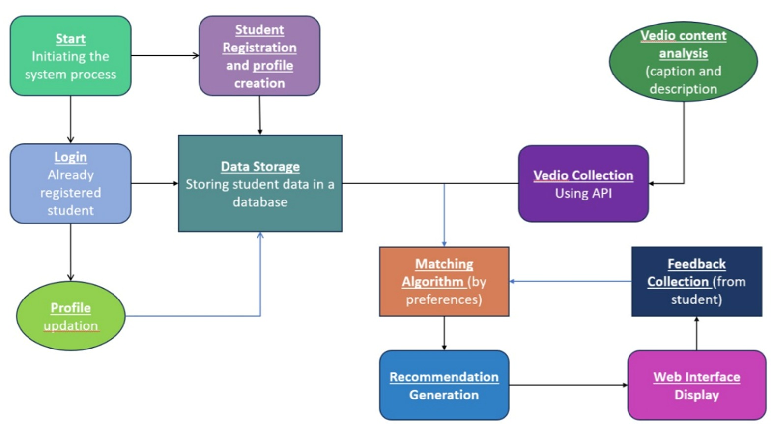
System Architecture

Slide 7
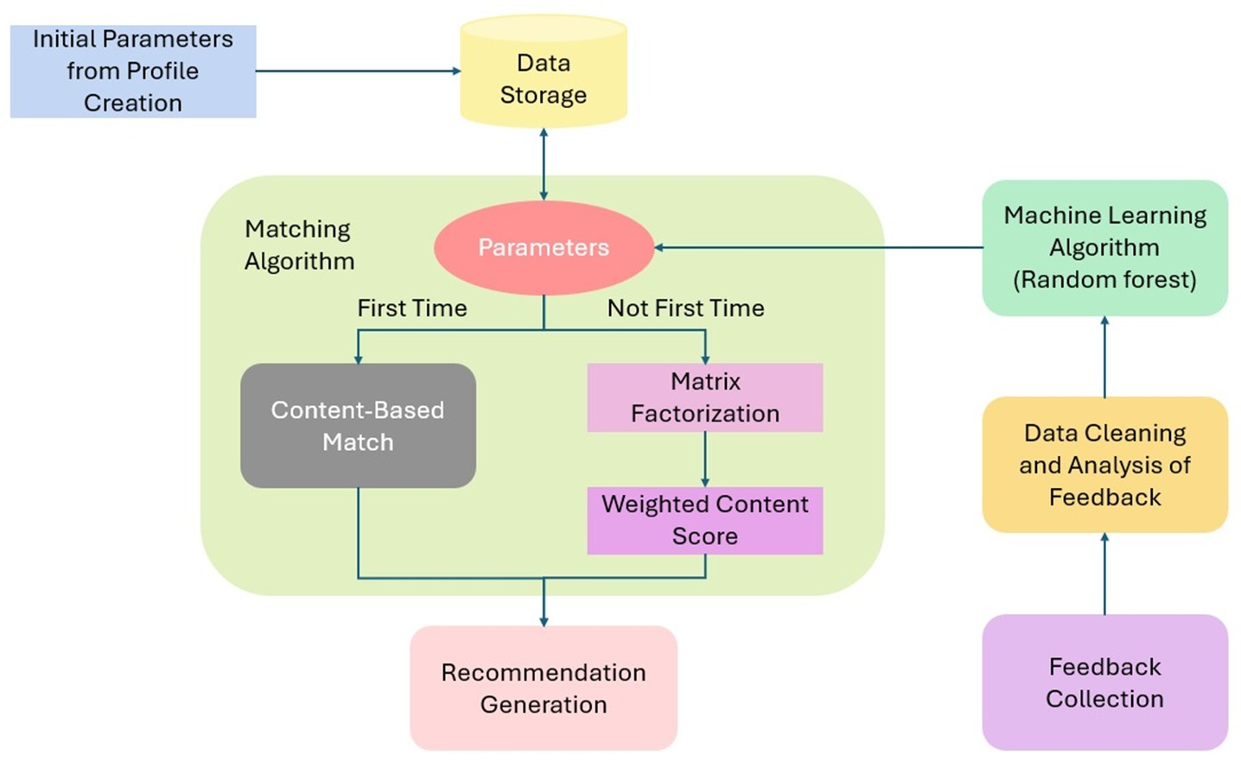

Slide 8
Technology Stack
Frontend: Streamlit
Backend: Python
Database: MySQL
Libraries: mysql.connector, pandas, scikit-learn, numpy, bcrypt
Machine Learning: Random Forest, Matrix Factorization, Content Based Filtering

Slide 9
Key Features
Secure User Registration and Login
Email and Password Validation for security
Personalized Learning Preferences selection
Video Recommendation System
Watch History Tracking for better suggestions
Automatic Feedback Collection to improve recommendation

Slide 10
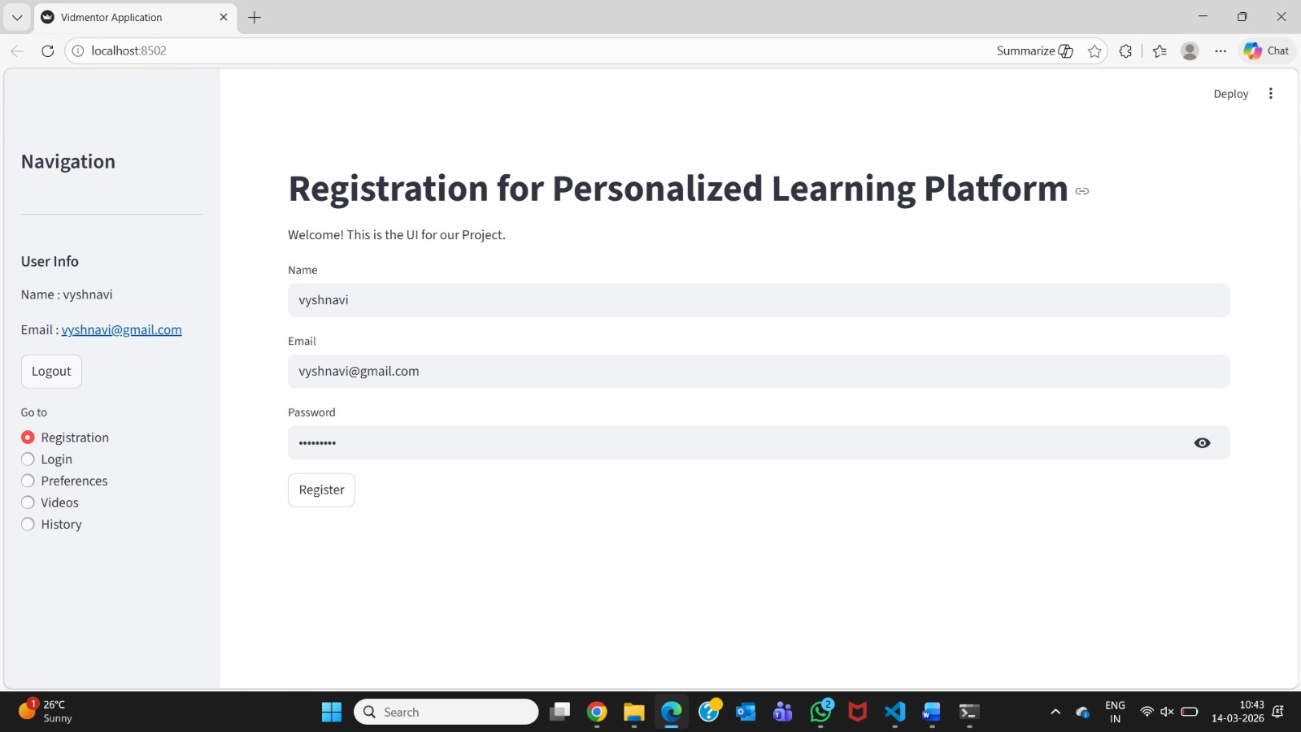
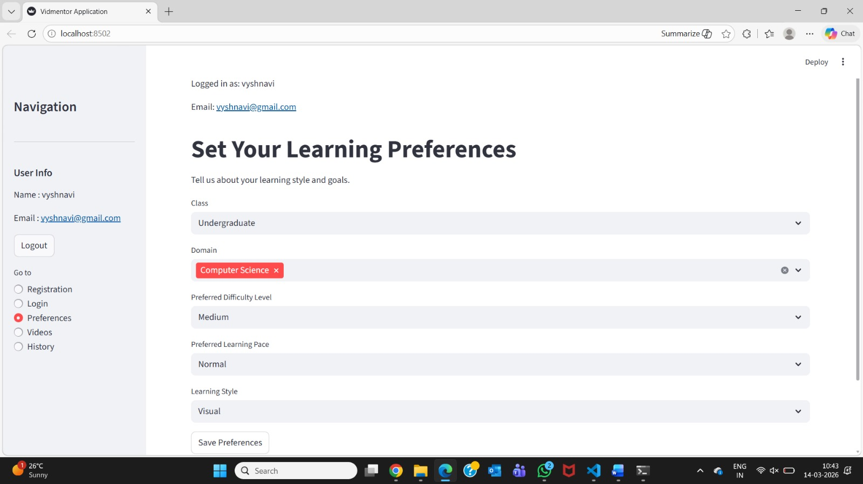
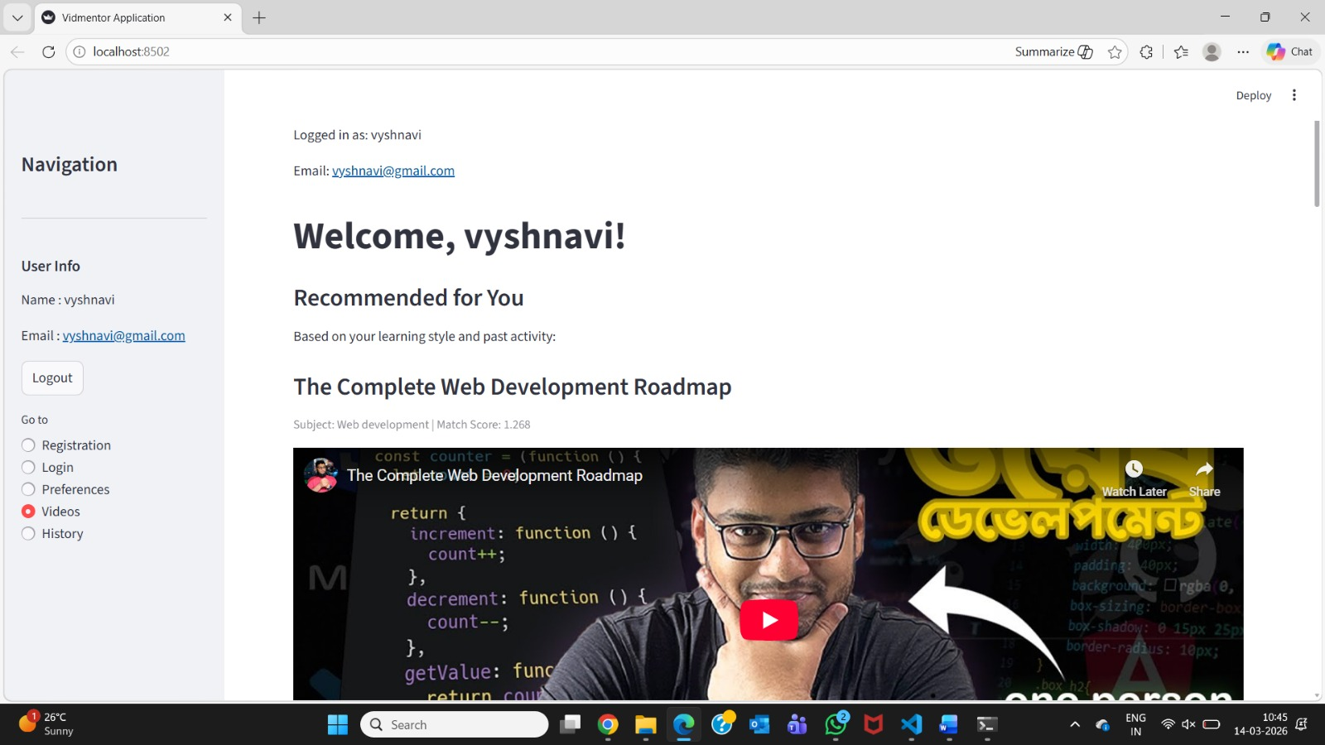
Demo Screenshots

Slide 11
Results
The system successfully registers and authenticates users securely.
Personalized video recommendations are generated based on student preferences and learning history.
The hybrid recommendation model improves the accuracy of suggested videos.
Watch history and feedback help the system continuously refine recommendations.
The Streamlit interface provides a simple and interactive learning experience for students.

Slide 12
Conclusion & Future Scope
Conclusion
Developed a personalized learning platform that recommends educational videos based on student preferences and behavior.
The hybrid recommendation system improves the relevance and accuracy of suggested content.
The system provides an interactive and adaptive learning experience for students.
Future Scope
Integrate more advanced AI models to improve recommendation accuracy.
Add support for multiple learning resources like notes, quizzes, and courses.
Develop a mobile application for easier access and wider usability.

Slide 13
Thank you

